Slide 1
Internal Combustion Engines
Faculty : Jayesh Parmar
STUDENT NAME: (1) Patel Vidhi A.
(2) Shah Darshan V.
(3) Patel Yash V.

Slide 2
introduction
Engine refers to a device which transforms one form of energy into other form.
“Heat engine is a modified form of engine used for transforming chemical energy of fuel into thermal energy and subsequently for producing work”

Slide 3
Continue…
Internal Combustion Engine:
“Its engine in which combustion of fuel take place inside the cylinder”
External Combustion Engine
“Its engine in which combustion of fuel take place outside the cylinder”

Slide 4
I.C. Engine | E.C. Engine
The combustion of fuel takes place inside the cylinder. | The combustion of fuel takes place outside the cylinder.
Compact in size & more efficient . | Large in size & less efficient.
Low initial cost. | More initial cost.
Working fluid is mixture of air & fuel. | Working fluid is steam.
Easier and quick starting of these engines. | Starting is difficult and more time is required .
Costly fuels like petrol and diesel. | Cheaper fuel may be used like coal.
More suitable for mobile applications. | Less suitable for mobile applications.

Slide 5
Classification of I.C Engines
Types of Fuel Used as :
Petrol , Diesel and Gas Engine
Nature of Thermodynamic Cycle as :
Otto ,Diesel , and Dual or Mixed cycle engine
No of Strokes Per Cycle as :
Four stroke engine and Two Stroke engine
Method of Ignition as :
S I Engine and C I Engine

Slide 6
Continue…
Method of Cooling as :
Air Cooled and Water Cooled Engine
Speed of the Engine as :
Low , High and Medium speed
NO. of cylinder as :
Single and Multi Cylinder Engine
Position of cylinder as :
Inline , V, radial , Opposed cylinder and Opposed piston Engine.

Slide 7
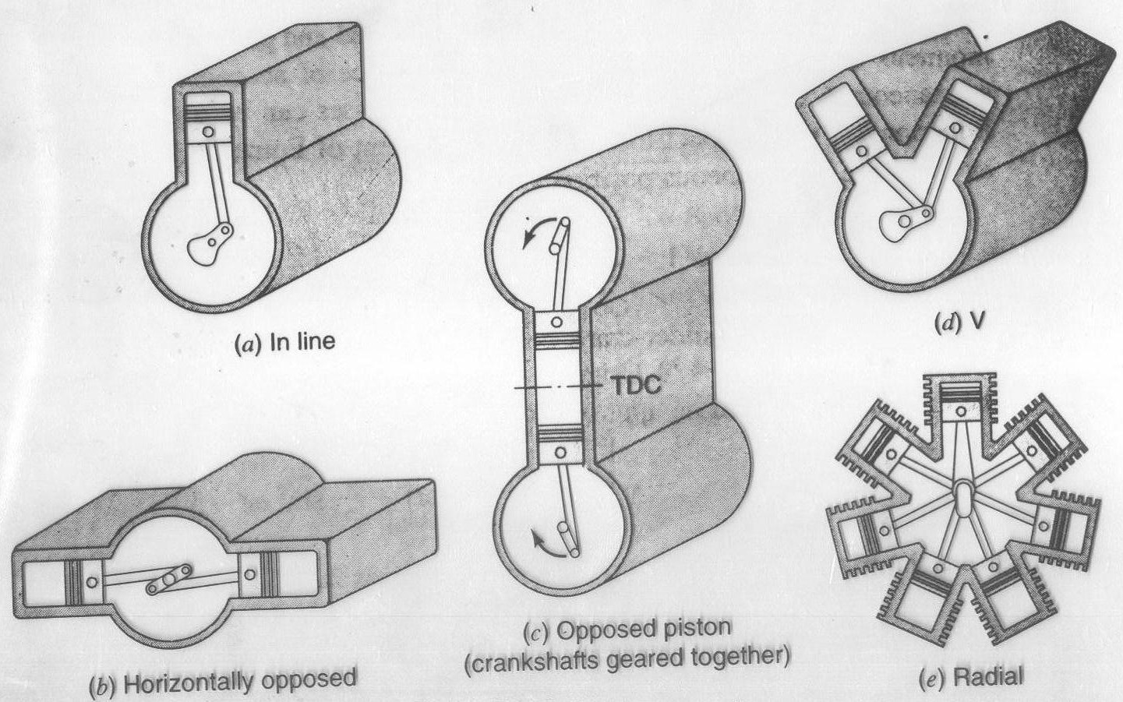

Slide 8
Engine Details

Slide 9
I.C. Engine Terminology
Bore :
Internal diameter of engine cylinder
Stroke :
Its linear distance traveled by piston when it moves from one end of cylinder to other end.
Dead Centers :
It’s the top most position of the piston.
It’s the bottom most position of the piston.

Slide 10
Continue…
Clearance Volume( Vc) :
Its volume contained between piston top and cylinder head when piston is at top or inner dead center.
Stroke Volume (Swept Volume):
Its volume displaced by piston in one stroke is known as stroke volume or swept volume.
V_{s} = Stroke Volume , L= Stroke length , d= bore
V_{s} = Πd²L/4

Slide 11
Continue…
Compression Ratio:
“The ratio of total cylinder volume to clearance volume is called the compression ratio (r) of the engine”
Total cylinder volume = V_{c} + V_{s}
Compression ratio, r =
r= V_{c} + V_{s} / V_{c}
Total cylinder volume
Clearance volume

Slide 12
Continue…
Piston Speed :
It is average speed of piston. it is equal to 2LN,
where,
N= Speed of crank shaft in, RPM
L= Stroke Length , m
Piston Speed, V_{p} = 2LN/60 m/s

Slide 13
Otto Four Stroke Cycle or 4 Stroke Petrol Engine or Spark Ignition Four Stroke Engine
The petrol engines work on the principal of theoretical Otto cycle, also known as Constant Volume cycle as shown in fig.
Inlet valves and exhaust or Outlet valves
Spark plug is fitted at top of cylinder head to ignition of the air fuel mixture.

Slide 15
Continue…
Piston perform 4 strokes to complete one working cycle.
Suction Stroke
Compression Stroke
Power Stroke
Exhaust Stroke

Slide 16
P-V diagram
Continue…

Slide 17
Continue…
1) Suction stroke
Inlet valve – open
outlet valve – closed
Piston moves from TDC to BDC.
Volume in cylinder increase , pressure will decreased.
This create pressure difference between the atmosphere and inside of cylinder.

Slide 18
Continue…
Due to pressure difference petrol & air mixture will enter into cylinder through carburetor.
At end of stroke cylinder will be filled completely with charge and inlet valve is closed.
This is represented by the horizontal line 1-2 on P-V diagram.
The crankshaft has now made half rotation i.e. 180˚ of crank angle.

Slide 19
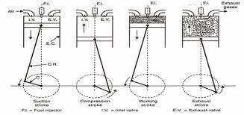

Slide 20
Continue…
2) Compression stroke
Inlet valve – closed
outlet valve – closed
Piston moves from BDC to TDC.
Charge contained in cylinder will compressed , so P,T increase.
At End of stroke Charge is ignited by Electric spark by electric spark plug.

Slide 21
Continue…
The combustion of charge release hot gases which increase pressure at constant volume.
This is represented by the curve 2-3 on P-V diagram.
This constant volume combustion process is represented by the vertical line 3-4 on the P-V diagram.

Slide 22
Continue…
3) Power stroke
Inlet valve – closed
outlet valve – closed
Piston moves from TDC to BDC.
The high P & T burnt gases force piston to perform this stroke, so, It’s also called Working or Expansion stroke.
Engine producing mechanical work during this stroke

Slide 23
Continue…
Here pressure is decrease and volume is gradually increased.
This is represented by the curve 4-5 on P-V diagram.
At end of the stroke outlet valve open which will release the burnt gases to the atmosphere.
This will suddenly bring the cylinder pressure to the atmospheric pressure.
This drop of pressure is represented by vertical line 5-2 on the P-V diagram.

Slide 24
Continue…
4) Exhaust Stroke
Inlet valve – closed
outlet valve – open
Piston moves from BDC to TDC.
Piston push the exhaust gases out of cylinder at constant pressure.
This process is shown on P-V diagram by horizontal line 2-1.

Slide 25
Diesel Four Stroke Cycle or Four Stroke Diesel Engine or Four Stroke Compression Ignition (C.I) Engine
The diesel engines work on the principal of diesel cycle, also called constant pressure heat addition cycle.
The basic construction of a four stroke diesel engine is Same as that of four stroke petrol engine, except instead of spark plug, fuel injector is mounted in its place. A fuel pump supplies the fuel oil to the injector at higher pressure.

Slide 26
history
Invented by Rudolf Diesel
Filled for a patent in 1894
First successful run in 1897
Engine proved that fuel could be ignited without a spark.
Early Uses: pipelines, electric and water plants, automobiles

Slide 27
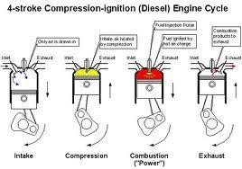
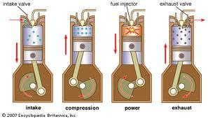
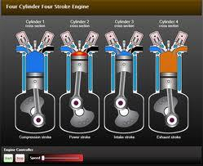

Slide 28
1) Suction stroke
Inlet valve – open
outlet valve – closed
Piston moves from TDC to BDC.
Volume in cylinder increase , pressure will decreased.
This create pressure difference between the atmosphere and inside of cylinder.

Slide 29
Due to pressure difference only the atmospheric air will enter into the cylinder through air filter and inlet.
At end of stroke, cylinder will be filled completely with air and inlet valve will be closed.
This is represented by the horizontal line 1-2 on P-V diagram.

Slide 30
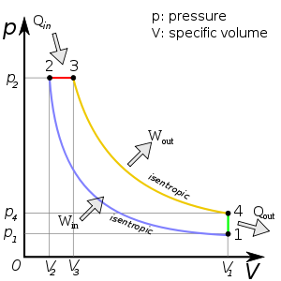

Slide 32
Continue…
2) Compression stroke
Inlet valve and Exhaust valve are closed.
Piston moves from BDC to TDC.
Air in the cylinder will compressed , so Pressure and Temp. of air increases.
At End of stroke Charge is ignited by Electric spark by electric spark plug.
This is represented by the curve 2-3 on P-V diagram

Slide 33
Continue…
Near the end this stroke, a metered quantity of the diesel fuel is injected into the cylinder.
Diesel fuel particle come in contact with high temp. air, it will ignite automatically, this is called auto or self ignition.

Slide 34
Continue…
3) Power stroke
Both Inlet and outlet valve are closed
Piston moves from TDC to BDC.
The fuel injection starts nearly at the end of compression stroke, but the rate of fuel injection is such that combustion maintains constant pressure.
Engine producing mechanical work during this stroke

Slide 35
Continue…
Here pressure is decrease and volume is gradually increased.
This is represented by the curve 4-5 on P-V diagram.
At end of the stroke outlet valve open which will release the burnt gases to the atmosphere.
This will suddenly bring the cylinder pressure to the atmospheric pressure.
This drop of pressure is represented by vertical line 5-2 on the P-V diagram.

Slide 36
Continue…
4) Exhaust Stroke
Inlet valve – closed
outlet valve – open
Piston moves from BDC to TDC.
Piston push the exhaust gases out of cylinder at constant pressure.
This process is shown on P-V diagram by horizontal line 2-1.

Slide 37
Difference Between Otto Cycle and Diesel Cycle Or Petrol (S.I.) Engine and Diesel (C.I.) Engine
S. I. Engine | C.I . Engine
High engine speed @3000 RPM. | Low to medium engine speed @500 to 1500 RPM.
Thermal efficiency is low due to lower C.R. | Thermal efficiency is higher due to higher C.R.
Maintenance cost less | Maintenance cost slightly higher.
Lighter in weight | Heavier in weight

Slide 38
S. I. Engine | C.I . Engine
Its works on Otto Cycle. | Its works on Diesel cycle.
Fuel is petrol which is Costly. | Fuel is diesel which is Cheaper than petrol.
Charge is ignited by spark plug. | Fuel is ignited by high temperature compressed air.
Air & petrol mixture is drawn during suction stroke. | Only air is drawn during suction stroke.
Quantity governing method is used for controlling speed. | Quality governing method is used for controlling speed.

Slide 39
Two Stroke Cycle Engines
All the processes in the two stroke cycle engine are completed in two strokes.
Two complete revolutions of crank shaft is required for completing one cycle in four stroke engine where in two stroke, only one revolution of crank shaft is required to complete four cycle.
Two stroke engine consists of a cylinder with one end fitted with a cylinder head and other end fitted with a hermitically sealed crankcase which enables it to function as a pump in conjuction with the piston.

Slide 40
Working of Two Stroke Petrol Engine

Slide 41
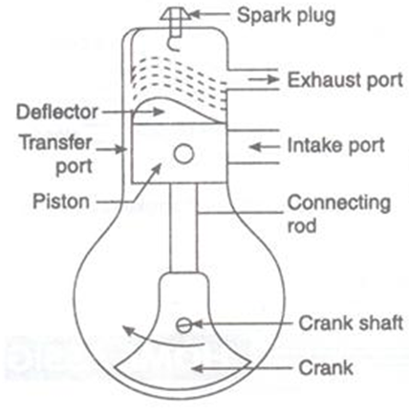
Continue…
Design of two-stroke engine was given by Dugald-Clerk in 1878.
In this engine, suction and exhaust strokes are eliminated. Instead of valves, ports are used. The exhaust gases are driven out of the cylinder by the fresh charge entering the cylinder.

Slide 42
Continue…
All the events in the two-stroke cycle are completed in two strokes.
In two strokes crank shaft makes one revolution; so the cycle is completed in one revolution of crank shaft.
The control of admission and exhaust in the engine is by ports; which open and close by movement of piston.

Slide 43
Continue…
The charge enters the crankcase through inlet port due to pressure difference when the piston is moving upward for compression.
The crankcase works as an air pump as the piston moves up and down.
The charge is compressed by the pumping action of the piston due to the design of crankcase.
The partially compressed charge is supplied to engine cylinder through transfer port from the crankcase.

Slide 44
Continue…
This compressed air traces a contour after striking the deflector and helps the exhaust gases to move out of the cylinder.
As the piston continues to move upward, exhaust and transfer port get closed and the compression is continued.
In the end of compression the spark is created which ignites the charge and the products of combustion thrust the piston from TDC to BDC.
This cycle is repeated again and again.

Slide 45
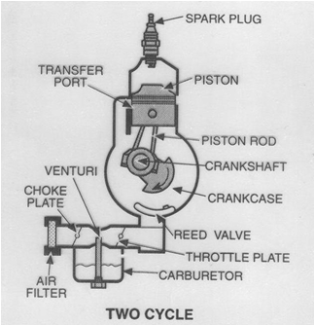
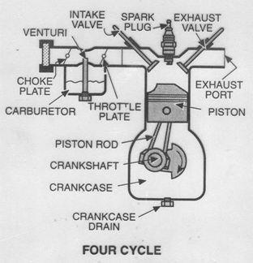
Petrol Engine (S.I.)

Slide 46
Working of Two Stroke Diesel Engine
The construction of diesel engine is similar to two stroke petrol engine except the fuel pump and fuel injector are there instead of carburetor and spark plug as in petrol engine.
The fresh air entering the cylinder, it pushes the burnt gases, so burnt gases come out from exhaust port, this pushing out of the exhaust gases is called scavenging.

Slide 47
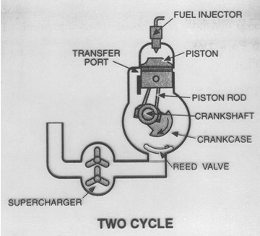
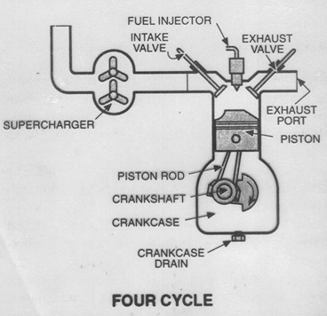
Diesel Engine (C.I.)

Slide 48
Difference Between 4 Stroke and 2 Stroke Engine
4 stroke engine | 2 stroke engine
Two complete revolution of crank shaft is required to complete one cycle. | Only one complete revolution of crank shaft is required to complete one cycle.
The inlet & outlet valves are required . | Ports are there instead of valves.
Require more space. | Require less space.
Heavy fly wheel is required. | Lighter fly wheel is required.

Slide 49
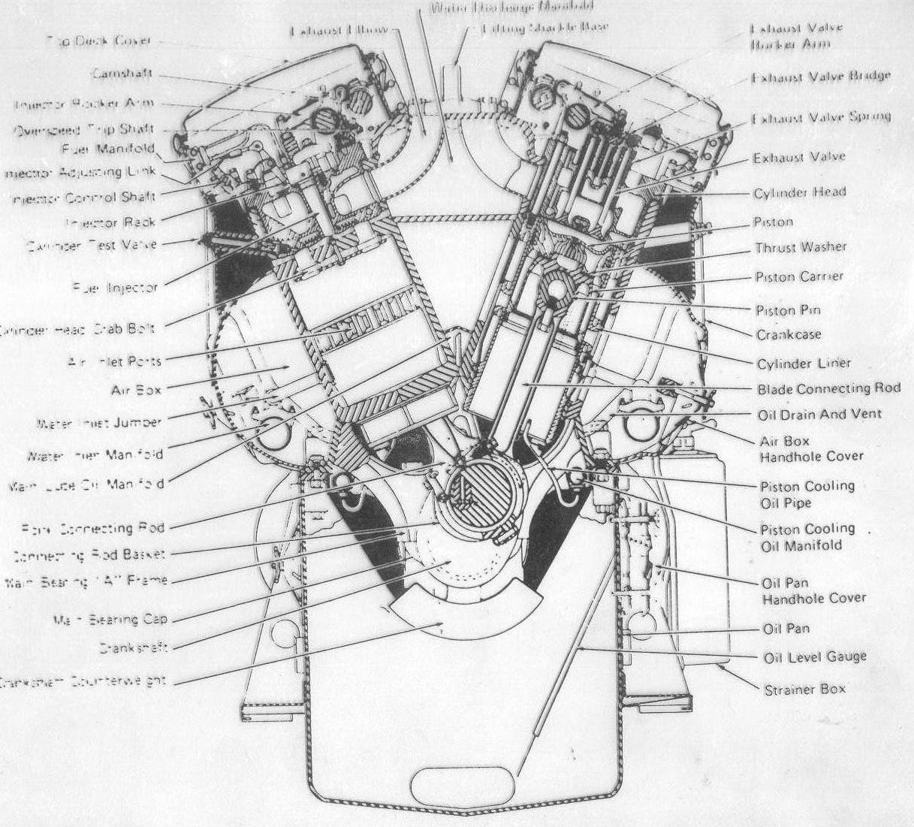
Two stroke engine

Slide 50
Indicated power
“The power produced inside the engine cylinder by burning of fuel is known as Indicated Power (I.P.) of engine”
^{Where} ,
a= area of the actual indicator diagram,cm³
l=base width of the indicator diagram,cm
s= spring value of the spring used in the indicator n/m²/cm
N/mm²

Slide 51
Continue…
Indicated Power of a Four Stroke Engine :
Pm=mean effective pressure, N/mm²
L= length of stroke , m
A= Area of cross section of the cylinder, m²
N= RPM of engine crank shaft,
n= Number of power strokes per minute.
For Two Stroke Engine :

Slide 52
Brake Power :
“It is the power available at engine crank shaft for doing useful work”
It is also known as engine output power
It is measured by dynamometer.
Let , W= Net Load Acting on the Brake Drum, N
R= Radius of the Brake Drum, m
N= RPM of the Crank Shaft,
T= Resisting Torque , N.m

Slide 53
Measurement of Brake Power
The power out put of the engine is measured by coupling a dynamometer to engine crank shaft.
Rope Brake Dynamometer
Hydraulic Dynamometer
Prony Brake Dynamometer
Eddy Current Dynamometer
Friction Power = I.P. – B.P.

Slide 54
Thank You…..

